Slide 1
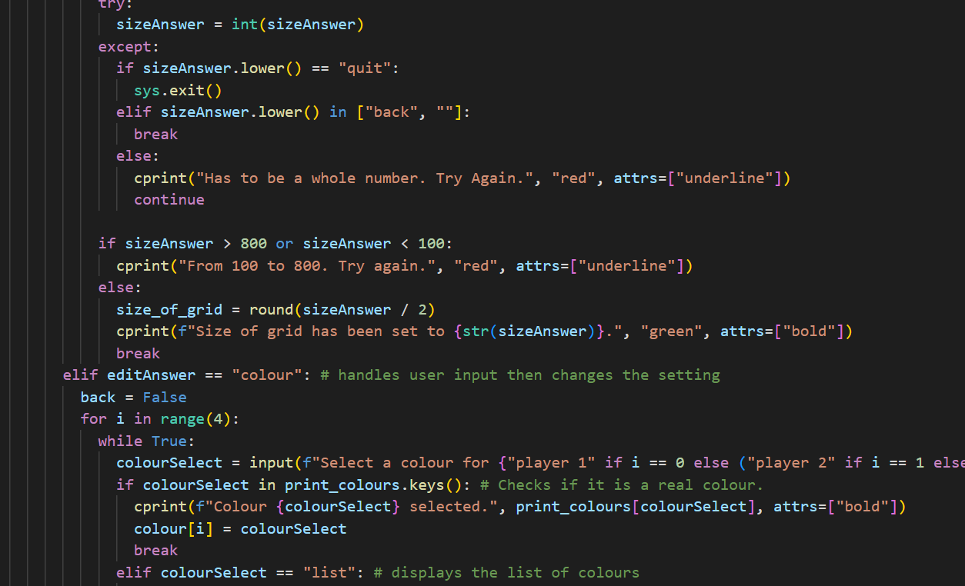
My Code
CAT Year 8, Investigation 1

Slide 2
Disclaimer:
I made my game more customisable by adding a menu and making some settings that are changeable. If you see some of that code where the changes are used just ignore it.

Slide 3
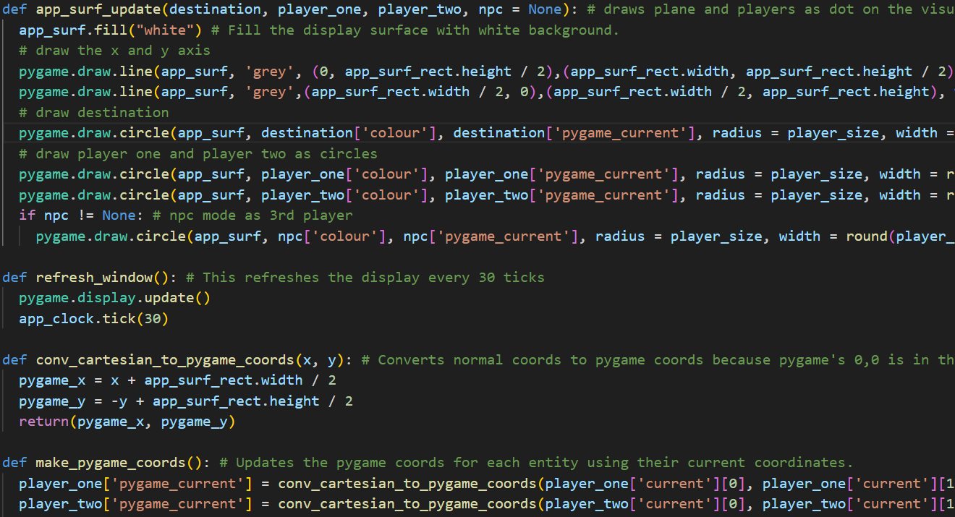
Part 1
Introduction? That’s what it’s called on the PDF… 😑
1.1 Create and explain a reusable means of achieving translations (10 Marks)
1.2 Use functions, validate input and document imports (10 Marks)

Slide 4
1.1 Create and explain a reusable means of achieving translations (10 Marks)
The Thinking Process🤔
The Application Process is later in Part 3 cause the PDF document is weird.
Let’s say the player wanted to move for the distance 5 in direction 1.
3
2
1
4
1
5
8
6
7

Slide 5
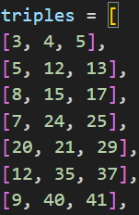



So, we can use the a and b values to move along the hypothenuse.
The distance is 5, and we need to move along the hypothenuse of a triple.
Since we are moving along the hypothenuse, the distance is practically the hypothenuse.
3
2
1
4
1
5
8
6
7

Slide 6









This will end up moving us along the hypothenuse.
To move in direction one, we will need to move across by B and up by A.
3
2
The distance is 5, and we need to move along the hypothenuse of a triple.
Since we are moving along the hypothenuse, the distance is practically the hypothenuse.
1
4
1
5
8
6
7

Slide 7
After that, it is just a matter of changing if A and B is positive or negative.
3
If the player wants to move player in direction 2, we can move across by A and up by B.
2
And for the other…
3
2
4
1
4
1
5
8
5
8
7
6
7
6

Slide 8
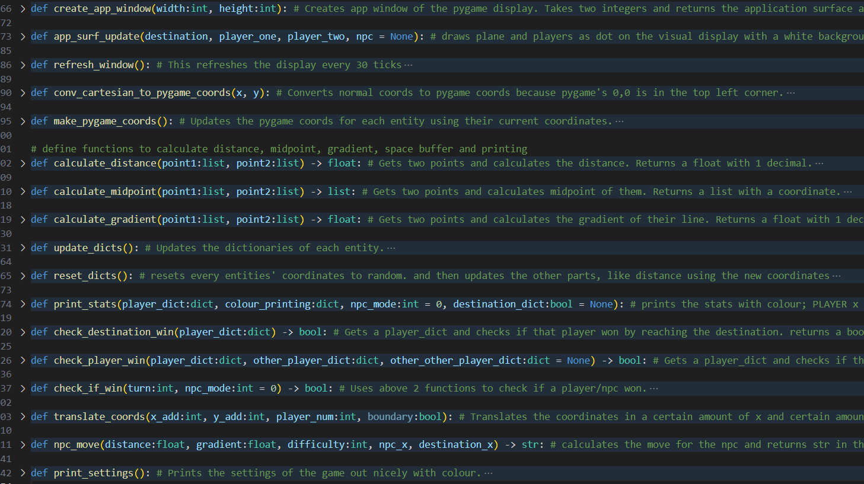
1.2.1 Use functions (5 Marks)
These are some of the functions I have for my code. I will explain them as they come.

Slide 9
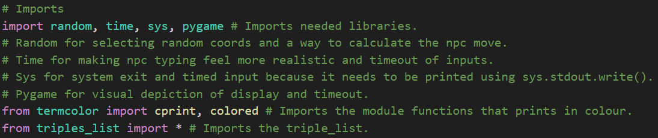
1.2.2 Document Imports

Slide 10
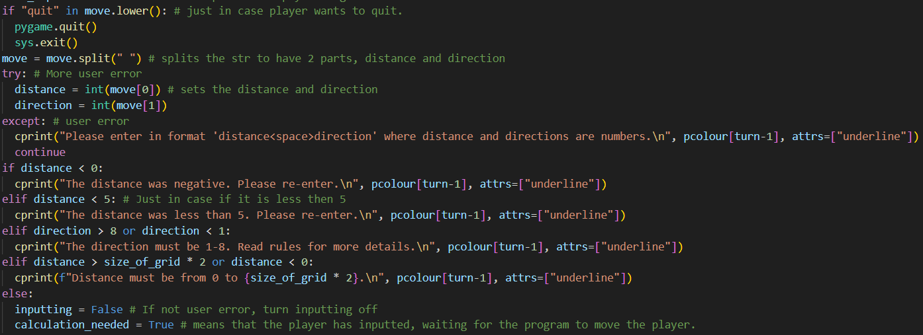
1.2.3 Validate Input (5 Marks)
Every single input in my code is checked for user error, and checked for quitting if the player enters “quit”. An example is above.

Slide 11
Part 2
Create and Place Entities 😀
2.1 Represent the two players and the destination as dictionaries (5 Marks)
2.2 Randomly place the players and the destination (5 Marks)
2.3 Calculate distance, midpoint and gradient (10 Marks)
2.4 Display information about players and the destination (5 Marks)

Slide 12
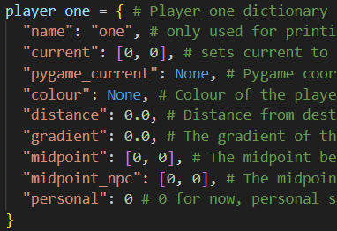
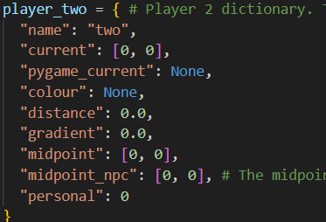
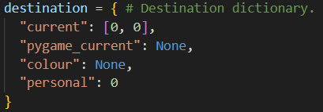
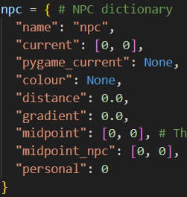
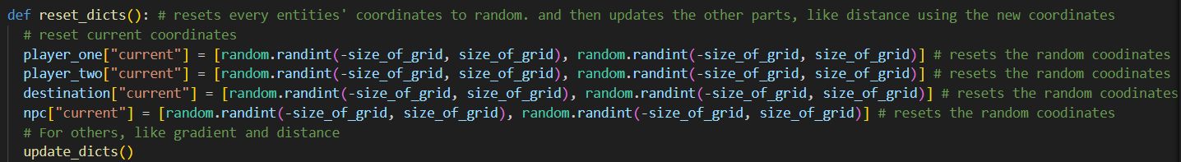
2.1 Represent the two players and the destination as dictionaries (5 Marks)
2.2 Randomly place the players and the destination (5 Marks)

Slide 13
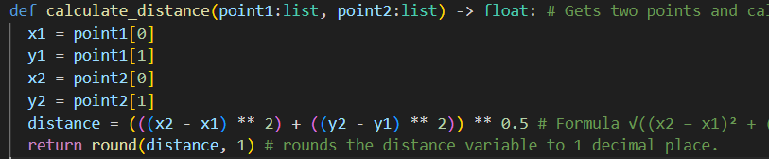
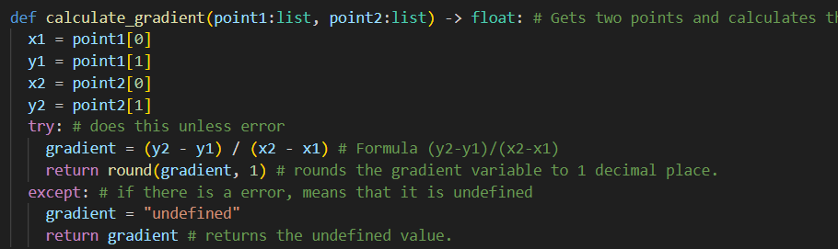
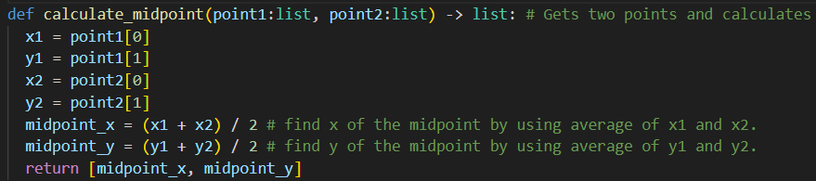
2.3 Calculate distance, midpoint and gradient (10 Marks)

Slide 14
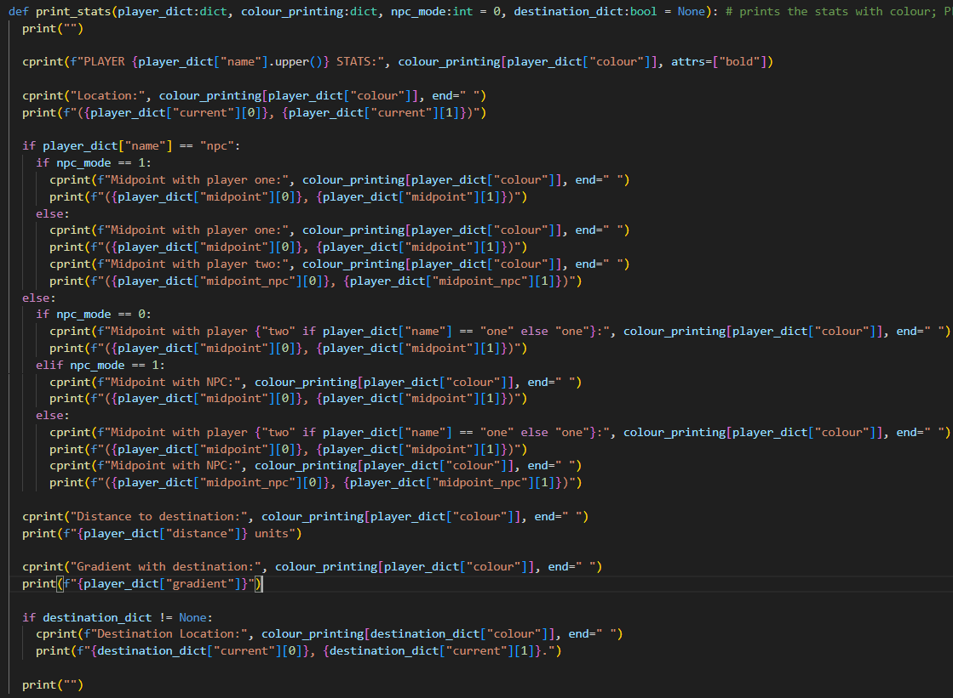
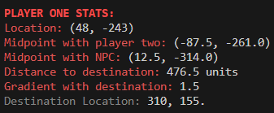
2.4 Display information about players and the destination (5 Marks)
I used this function to print the player stats at the start of the game and after each move for player 1, player 2 and NPC and the location of the destination.

Slide 15
Part 3
Take turns moving players 🤪
3.1 Use the personal space buffer to identify a winner (5 Marks)
3.2 Move players along the hypotenuse of a right-angled triangle (10 Marks)

Slide 16
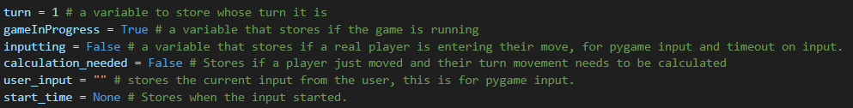
My Game Loop (Variables)
In my game loop, I use 6 variables:
Turn
GameInProgress
Inputting
Calculation_needed
User_input
Start_time
I set these variables before my game loop.

Slide 17
My Game Loop (Structure)
Firstly, I made my game so that you must input into Pygame instead of into the terminal to stop the players having to keep switching screens.
Also, the code is too complicated so I will just show the structure here.
Set Variables
Game Loop
Pygame Event Loop
If the Pygame is exited
End the program
If the screen is clicked
Inputting = True, Start timer
NPC move if it is the NPC’s turn
If a key is pressed and inputting is True
Add the key to User_input
If it was the return key
Submits input and Calculation_needed = True
If it was the backspace
Remove last letter of User_input
If Calculation_needed is True
Do movement, finish turn
Check if the player has run out of time
Pick a random triple, Calculation_needed = True

Slide 18
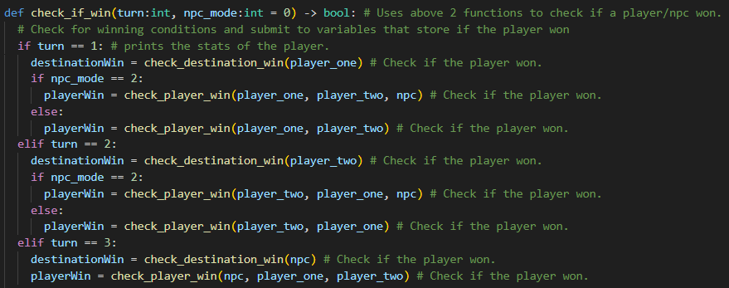
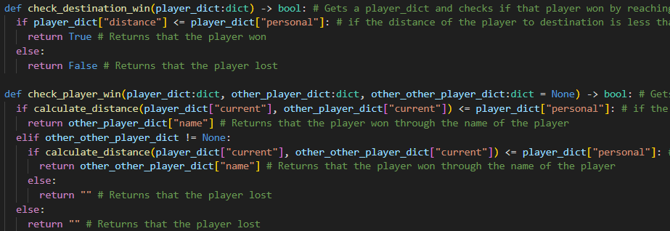
3.1 Use the personal space buffer to identify a winner (5 Marks)
I assumed that the personal space buffer is a circle around the player/destination.
I can check if the player has gotten into the PSB of the destination or other player by checking if the distance from the player to the destination is less or equal to 10.
I can do this by using the distance function.

Slide 19
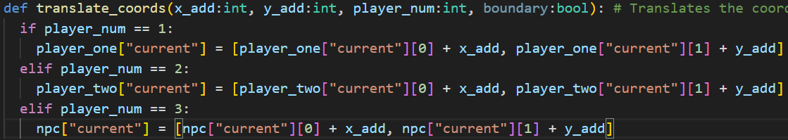
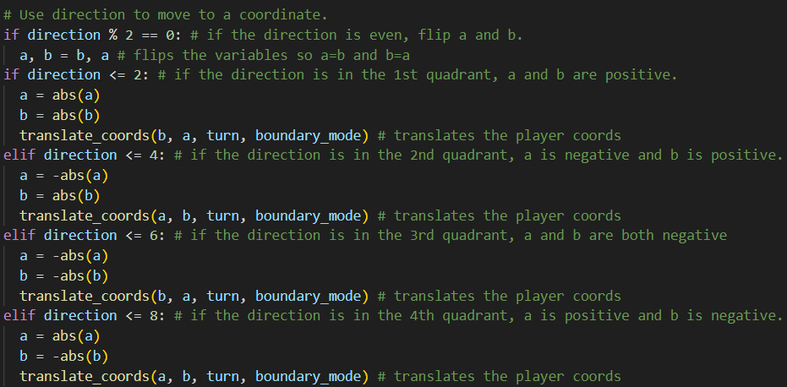
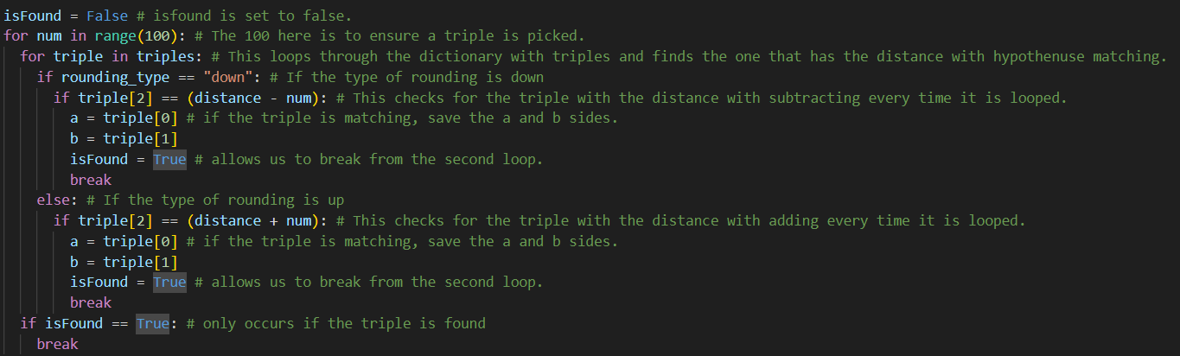
3.2 Move players along the hypotenuse of a right-angled triangle (10 Marks)
The Application Process

Slide 20
Part 4
Advanced Features 🤓
4.1 Introduce a time penalty (1 Mark)
4.2 Design and implement player three as an NPC (5 + 2 Marks)
4.3 Visual depiction of gameplay (2 Marks)

Slide 21
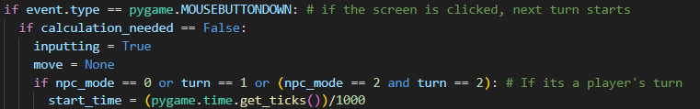
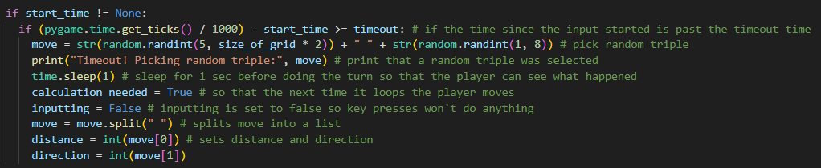
4.1 Introduce a time penalty (1 Mark)
Start Timer:
Check if the time limit has passed:

Slide 22
4.2 Design and implement player three as an NPC (5 + 2 Marks)
The Design (5 Marks)
Gradient & Distance
The distance that the NPC enters is just the distance of the NPC to the destination.
The direction is harder to calculate…

Slide 23
4.2 Design and implement player three as an NPC (5 + 2 Marks)
The Design (5 Marks)
My NPC uses the gradient to calculate its direction.
When gradient is 0, the gradient line is pointing at 90 degrees.
Gradient & Distance
The distance that the NPC enters is just the distance of the NPC to the destination.
The direction is harder to calculate…
And if it is less than 0 it is in the bottom half.
This can be used so that if the gradient is bigger than 0 the direction is in the upper half…

Slide 24
4.2 Design and implement player three as an NPC (5 + 2 Marks)
The Design (5 Marks)
So, if the gradient is above one the direction is 2, and when its below -1, the direction is 7.
We can make this direction more specific, as when the gradient is 1, it points at 45 degrees.
This is also with negative.

Slide 25
4.2 Design and implement player three as an NPC (5 + 2 Marks)
The Design (5 Marks)
The other side of the cartesian plane is just mirrored of this, just going in the other direction.
We can use the X position of the NPC and destination to figure which side it is.
Therefore, the direction is 1.
All we need to do is to join the distance and direction to make the NPC move.
If the X of the Destination is greater than the X of the NPC, it means that the direction is on the right side, and vice versa for the other side.
4, 3
1
0, 0
The gradient is greater than 0, so it is in the upper half.
The gradient is less than 1, so it is either 4 or 1.
The X of direction is bigger than the X of NPC, therefore it is on the right side, which is 1.

Slide 26
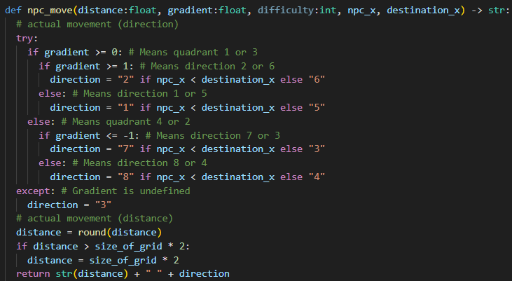
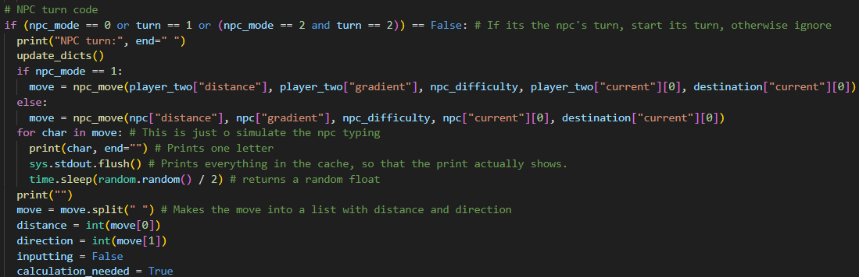
4.2 Design and implement player three as an NPC (5 + 2 Marks)
The Implementation (2 Marks)

Slide 27
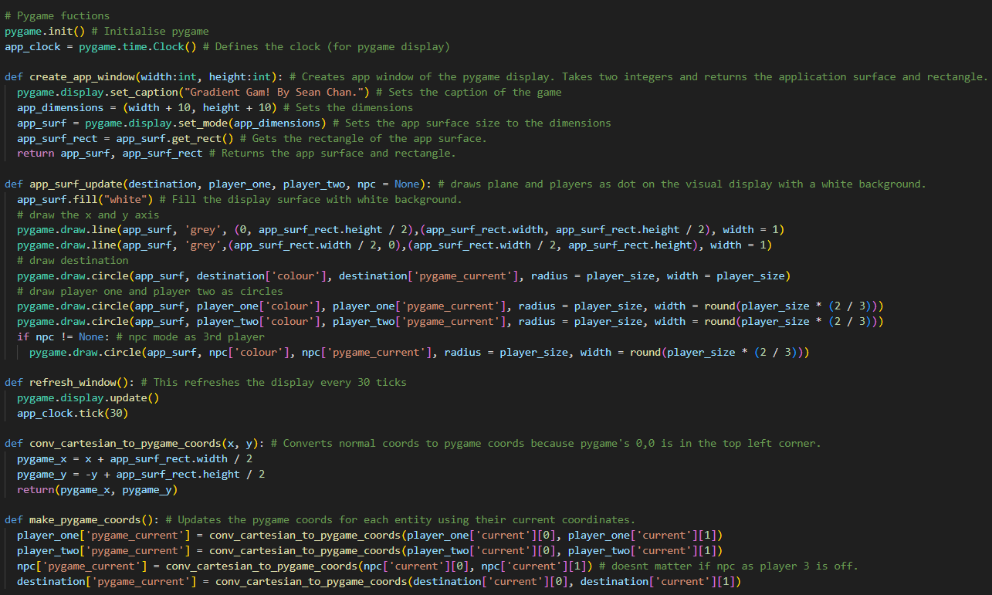
4.3 Visual depiction of gameplay (2 Marks)
This is how I initialise the display.
This is to update the display.
I used Mr Kigodi’s code…

